Slide 1
Deep Residual Learning for Image Recognition
Kaiming He, Xiangyu Zhang, Shaoqing Ren, Jian Sun

Slide 2
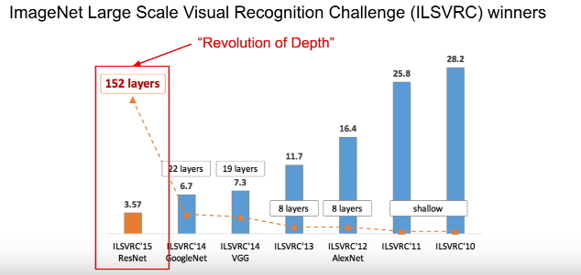

Slide 3
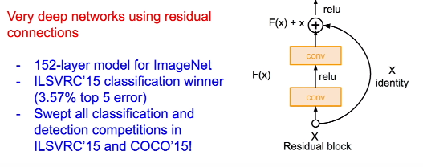

Slide 4
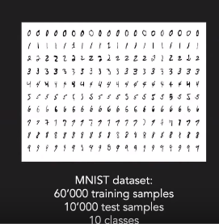
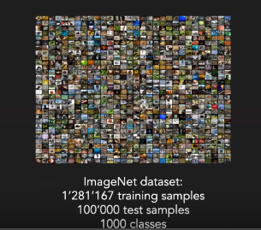
Why should we make deep networks? & How deep it should be?

Slide 5
What happens when we continue stacking layers on a plain neural network?

Slide 6
What happens when we continue stacking layers on a plain neural network?
NO!!

Slide 7
Why it is not okay to add more layers?
Vanishing/Exploding gradients
Degradation Problem

Slide 8
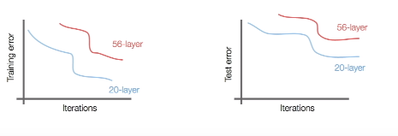
Degradation Problem

Slide 9
Hypothesis:
Deeper models are harder to optimize. This is an optimization problem
Reason:
Deeper models should perform at least as well as the Shallower models
Solution by Construction:
Taking the learned layers from the shallower models and then for the remaining additional deeper layers add identity x

Slide 10
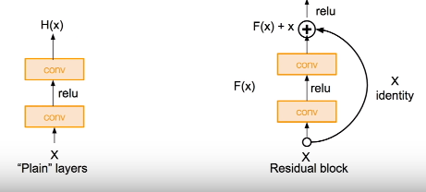
Residual Learning & Residual Functions

Slide 11
